Slide 1


Outpatient Doctor
Appointment System
BATCH-1
TEAM MEMBERS:
ABHIJEET
SAI KIRAN
SRIJA
AYUSH

Slide 2
CONTENTS
Abstract
Introduction
Functional Requirements
UML Diagrams
Use Case Diagram
Class Diagram
Activity Diagram
Module Implementation Overview

Slide 3
ABSTRACT
The outpatient doctor appointment system is a software solution designed to streamline and automate the process of scheduling, managing, and tracking appointments for patients in outpatient medical facilities. This system improves efficiency by providing a centralized platform for patients, doctors, and administrative staff to coordinate and manage appointments effectively.

Slide 4
INTRODUCTION
Outpatient Doctor Appointment System
The outpatient doctor appointment system is a digital platform designed to simplify and automate the process of scheduling and managing appointments in outpatient healthcare facilities. It allows patients to book, schedule, or cancel appointments online, while enabling doctors to manage their availability and access patient records efficiently. By reducing administrative tasks, minimizing wait times, and improving patient-provider communication, this system enhances the overall outpatient care experience and ensures a seamless, patient-centric approach to healthcare management.

Slide 5
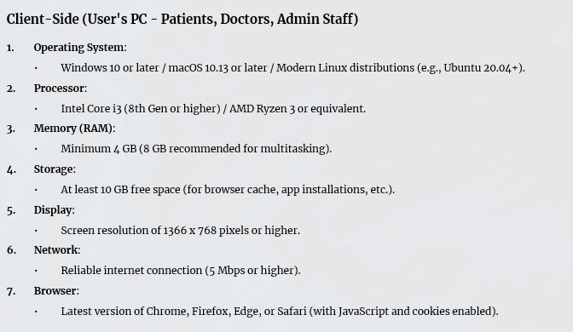
Functional Requirements:

Slide 6
Functional Requirements:
Server-Side (For Hosting the System)
Operating System:
Linux (Ubuntu Server 20.04+, CentOS 7+ preferred) or Windows Server 2019+.
Processor:
Quad-core processor (Intel Xeon or AMD EPYC recommended).
Memory (RAM):
Minimum 8 GB (16 GB recommended for handling multiple concurrent users).
Storage:
SSD with at least 100 GB free space (expandable based on database size).
Database:
MySQL (with sufficient storage for patient and appointment data).
Web Server:
Apache/Nginx with PHP 7.4+ or Node.js (depending on the backend framework).
Network:
High-speed internet with a minimum upload/download speed of 10 Mbps and static IP.
Additional Software:
Docker (if using containerized deployment).
SSL certificate for secure connections.

Slide 7
UML DIAGRAMS:
UML (Unified Modeling Language) diagrams are visual representations used to model and design systems in software development. They help developers, stakeholders, and designers understand the system's structure, behavior, and workflows before implementation. UML diagrams are commonly divided into main categories
1.Use Case Diagrams
2.Class Diagrams
3.Activity Diagrams

Slide 8
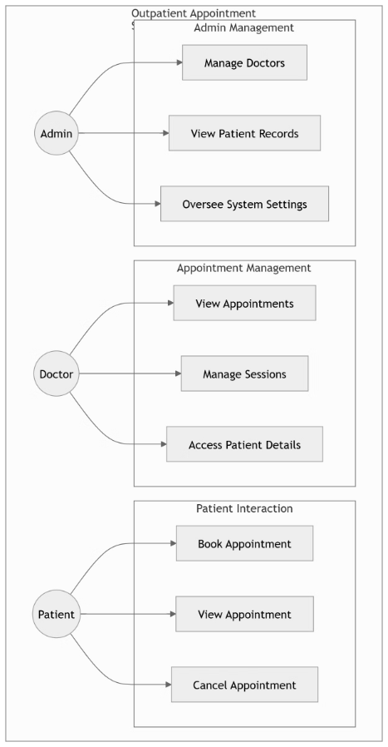
USE CASE DIAGRAM

Slide 9
Use Case Diagram
Actors:
Doctor
Patient
Admin
Key Use Cases:
Doctor:
View appointments
Manage sessions
Access patient details
Patient:
Book an appointment
View appointment status
Admin:
Add/manage doctors
View all patient records

Slide 10
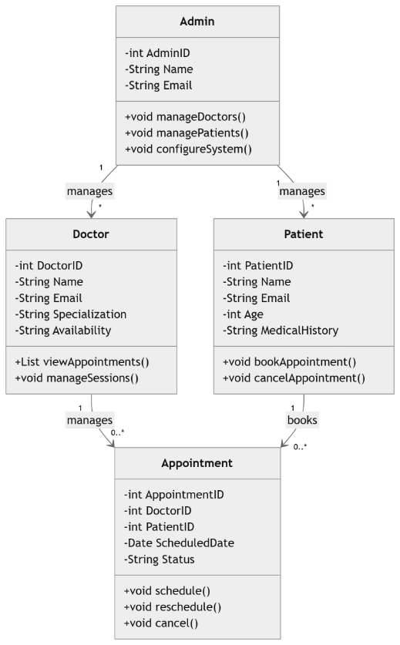
Class Diagram

Slide 11
Class Diagram
Key Classes:
Doctor
Attributes: DoctorID, Name, Email, Specialization, Availability
Methods: viewAppointments(), manageSessions()
Patient
Attributes: PatientID, Name, Email, Age, MedicalHistory
Methods: bookAppointment(), cancelAppointment()
Appointment
Attributes: AppointmentID, DoctorID, PatientID, ScheduledDate, Status
Methods: schedule(), cancel()
Admin
Attributes: AdminID, Name, Email
Methods: manageDoctors(), managePatients()

Slide 12
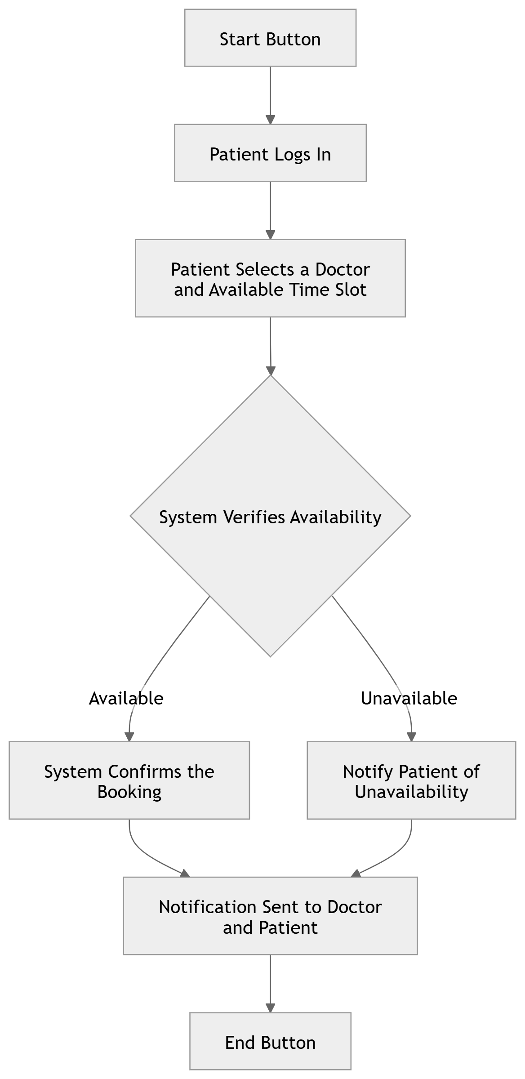
Activity Diagram
For patient

Slide 13
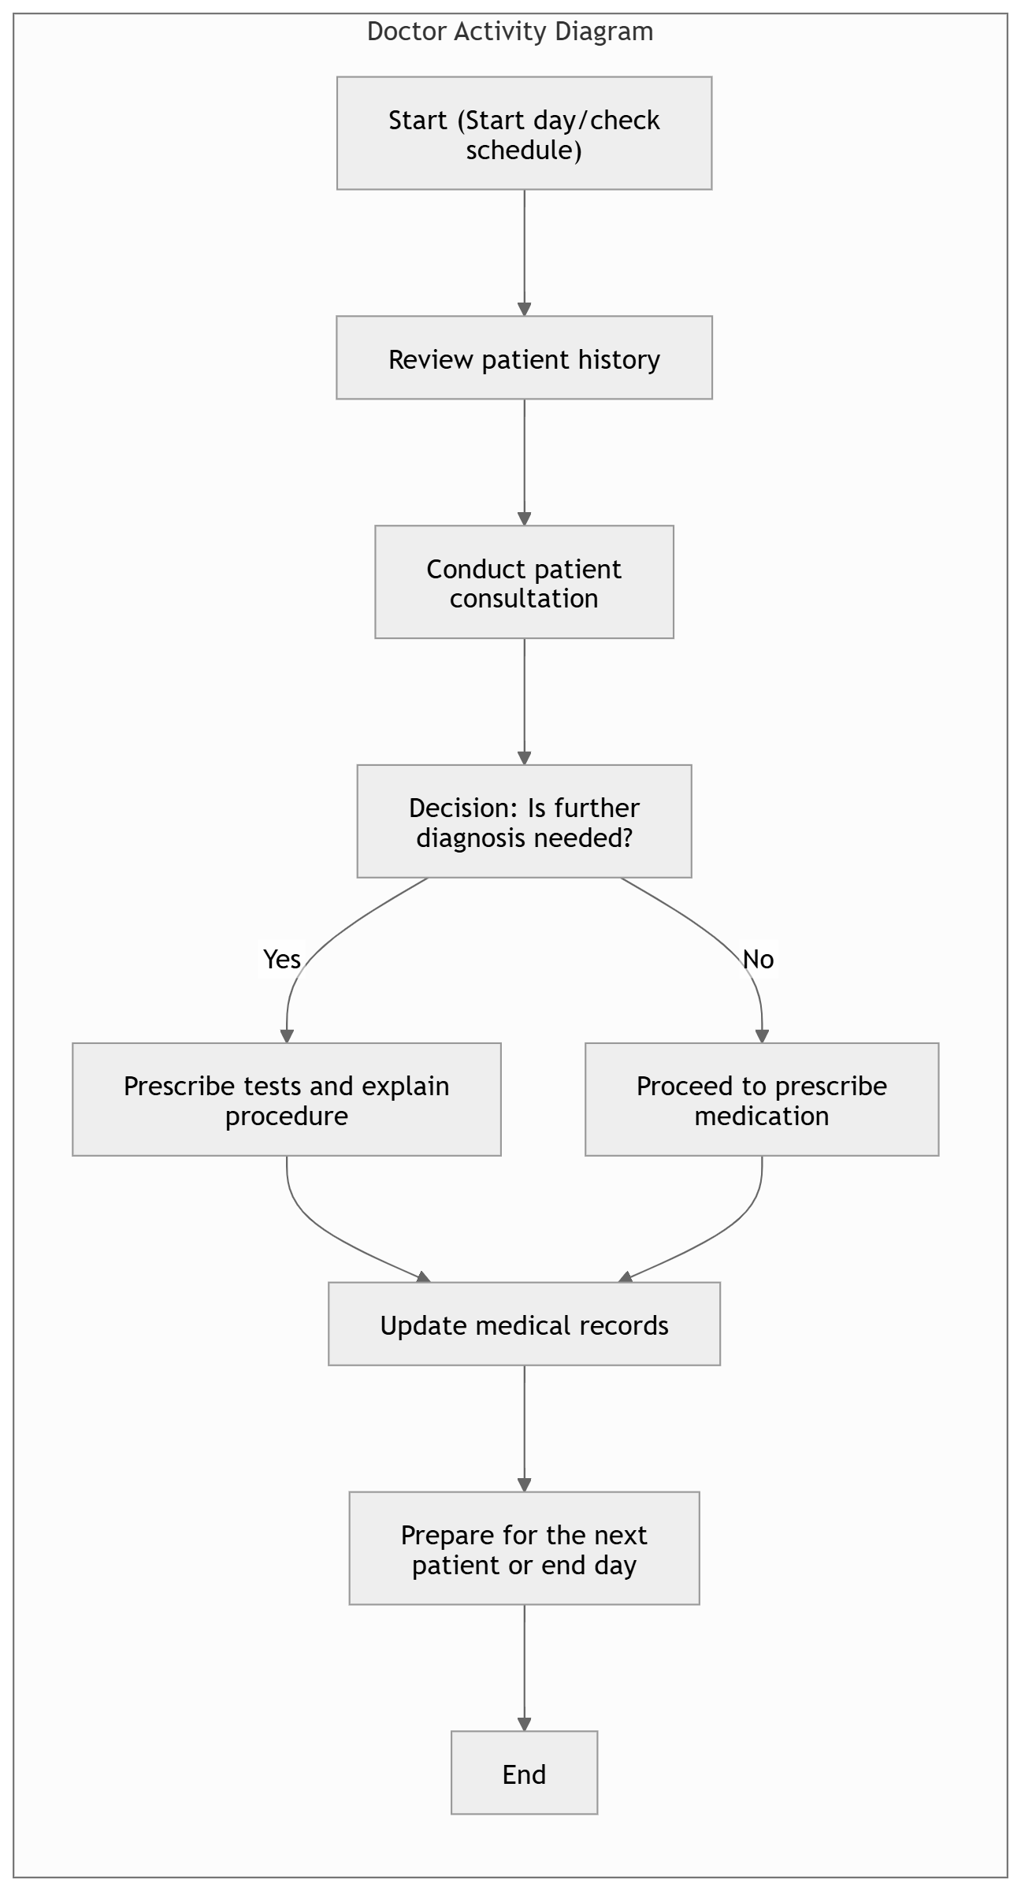
Activity Diagram for the Doctor

Slide 14
Activity Diagram
Sample Activity Flow: Appointment Booking
Patient logs in.
Patient selects a doctor and available time slot.
System confirms the booking.
Notification sent to the doctor and patient.

Slide 15
Module Implementation
1
User Authentication and Registration
2
Doctor Availability Management
3
Appointment Scheduling Interface
Implement user registration, login, and profile management.
Enable doctors to set their availability and manage patient requests.
Design an interface for users to select doctors, time slots, and reasons for appointments.
4
Appointment Management
5
Patient Information Management
6
Notification System
Integrate email and/or SMS notifications for appointment reminders, bookings, and cancellations.
Manage appointment details, prevent conflicts, and provide scheduling status updates.
Store patient information securely and provide functionality for updates.
7
Admin Dashboard
Design an admin dashboard for user management, doctor and appointment management, and patient information management.

Slide 16
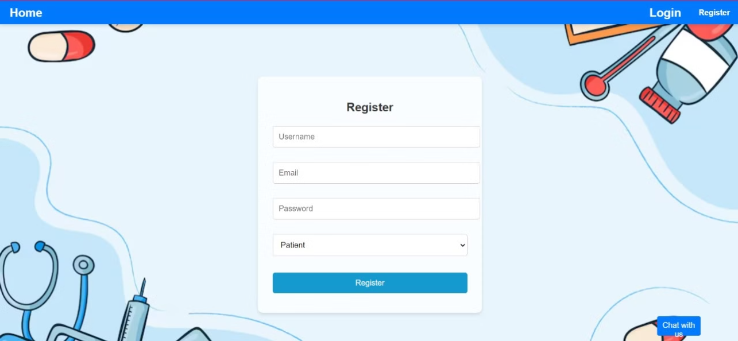
MILESTONE: 1
User Authentication and Registration
Implement user registration functionality, develop a user registration mechanism with an integrated email through patient or doctor.
Output Screenshot:

Slide 17
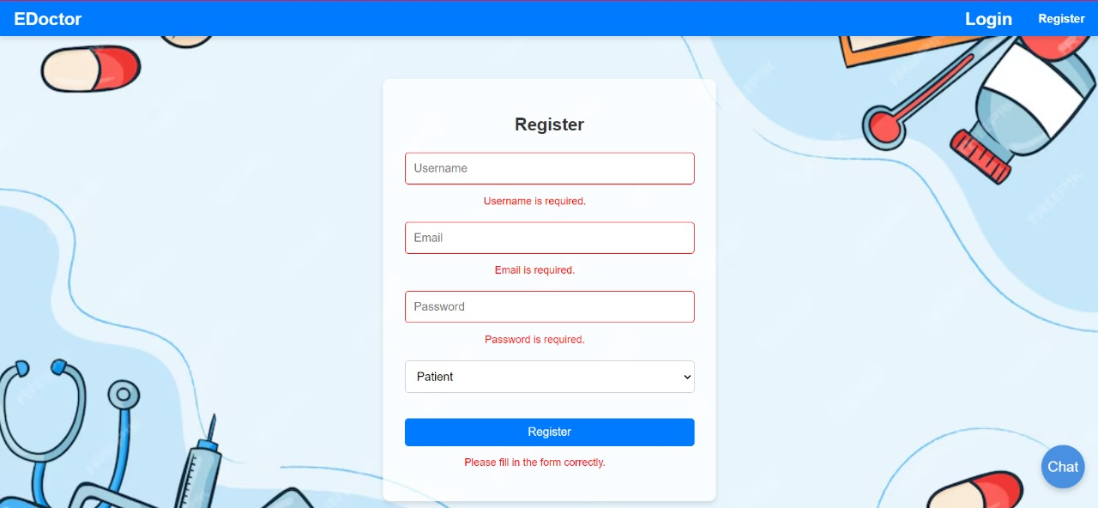
Validation for the Registration

Slide 18
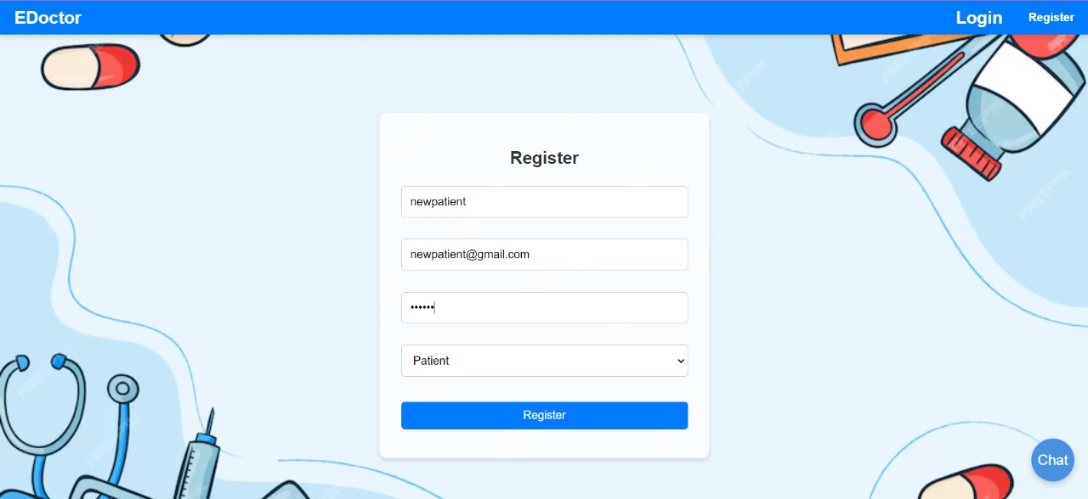

Slide 19
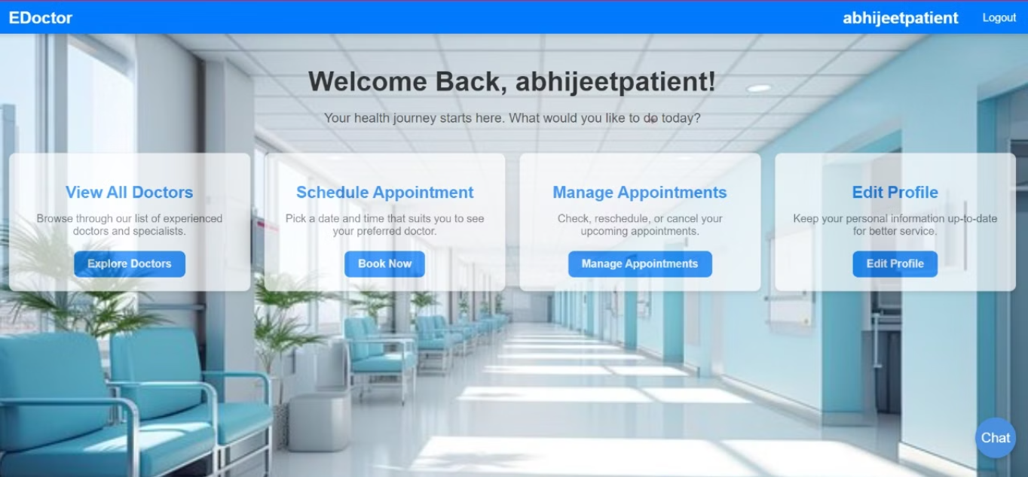
User login mechanisam
User have the access to login into the page through their registered email and password.
Output Screenshot:

Slide 20
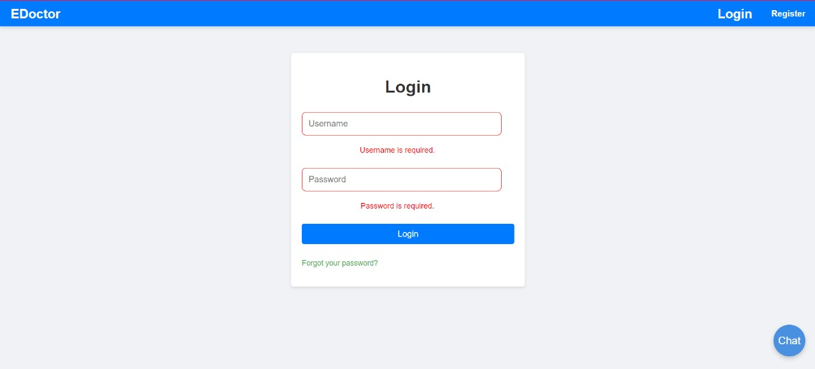

Slide 21
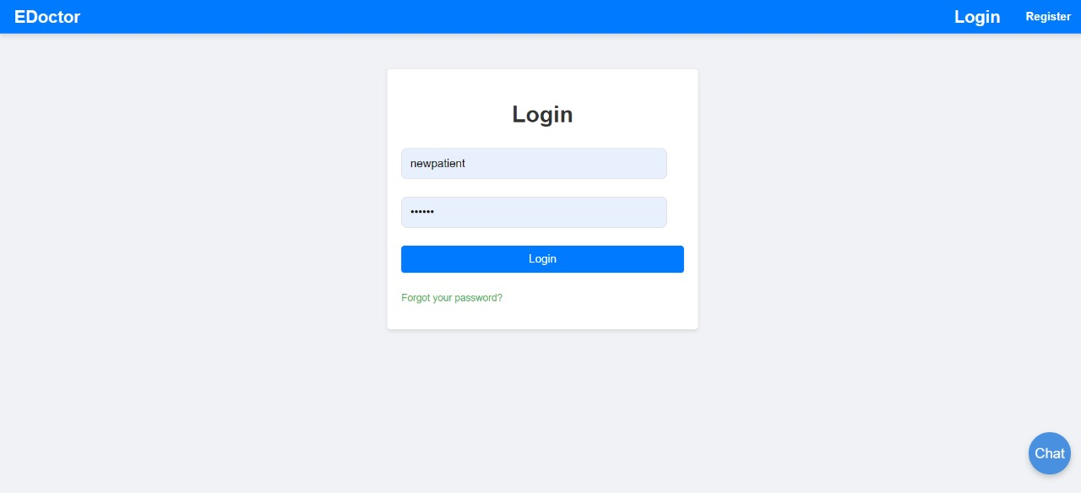

Slide 22
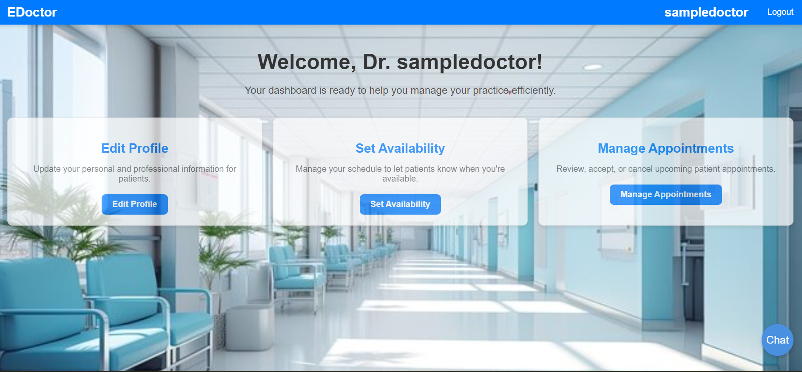
Milestone 2:
Designing a database for the creation of the doctor dashboard
Output Screenshot:

Slide 23
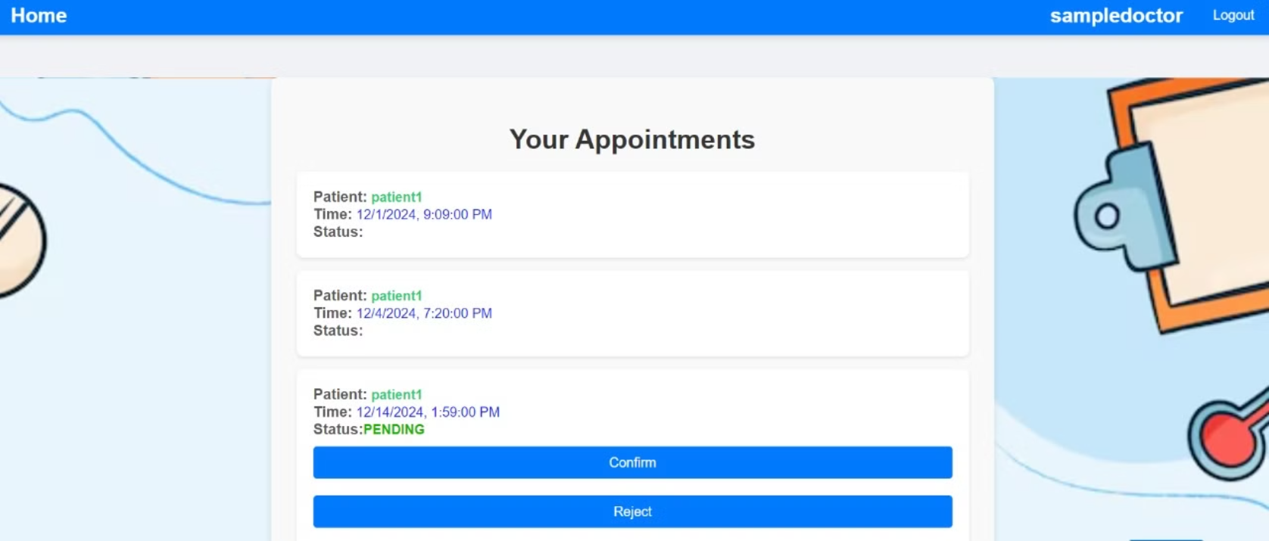
Doctor Visibility Appointments
Output Screenshot:

Slide 24
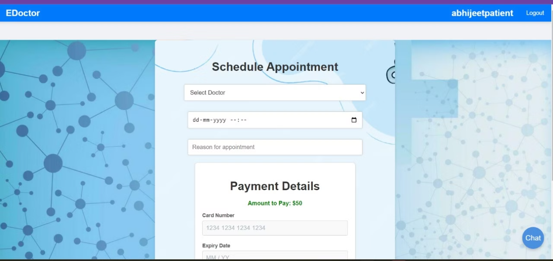
Milestone 3:
Appointment Scheduling Interface
Design and develop the interface for appointment scheduling, implement functionality for users to select doctors, preferred time slots, and reasons for the appointment, and integrate the scheduling interface with the backend for storing appointment details.
Output Screenshot:

Slide 25
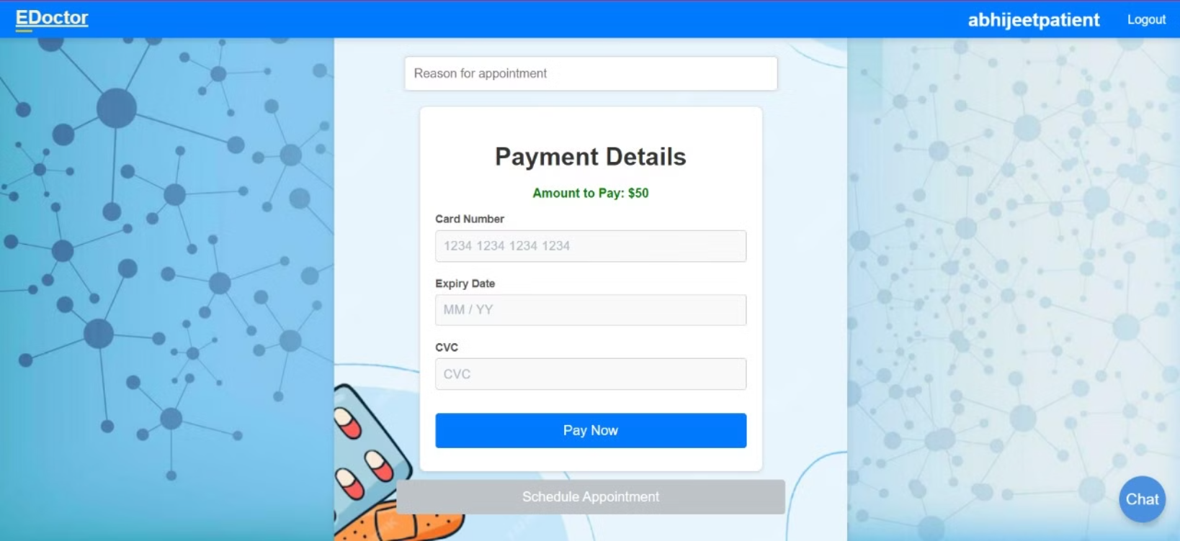
Payment Details:

Slide 26
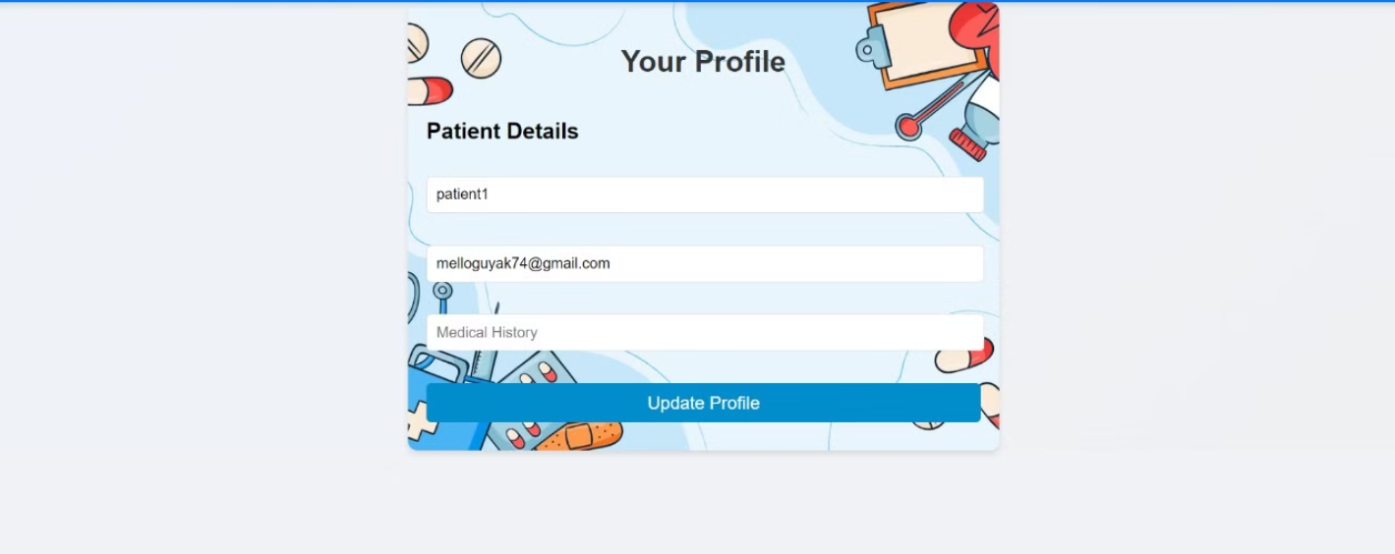
Milestone 4:
Patient Profile
Output Screenshot:

Slide 27
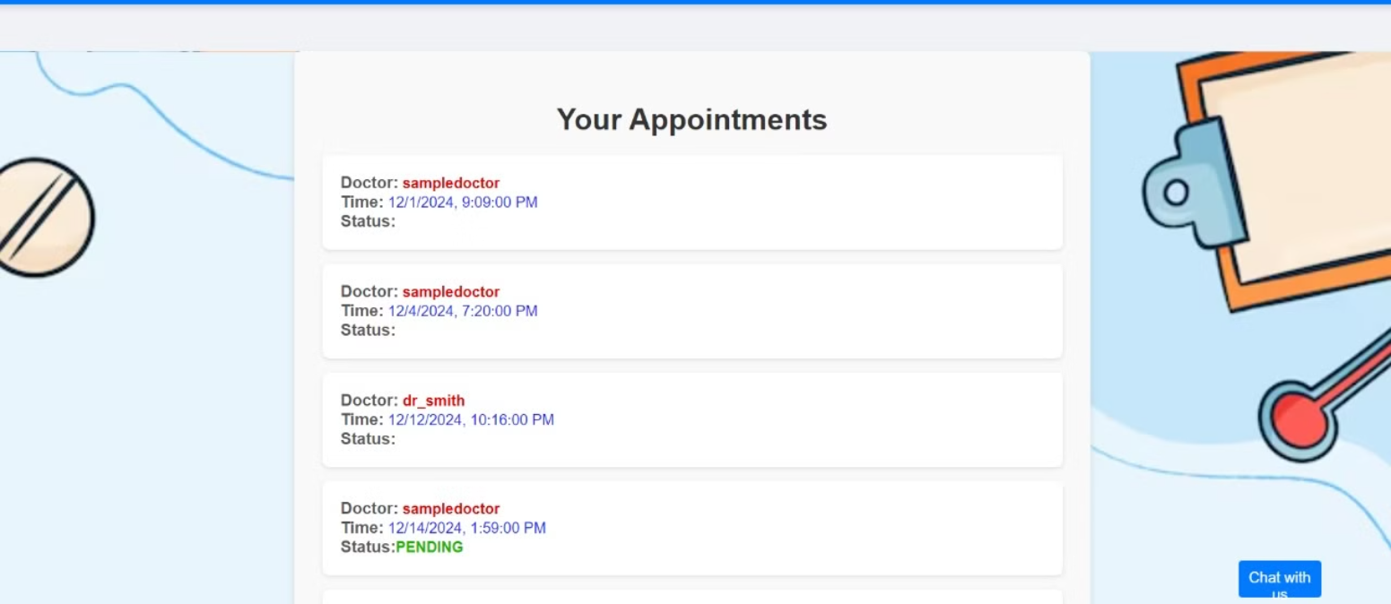
Patient Visibility Appointments
Output Screenshot:

Slide 28
Module 6: Notification System
Notification System
Integrate email notification services, develop triggers and notifications for appointment reminders, new bookings, and cancellations, and implement a system for handling and tracking notifications.

Slide 29
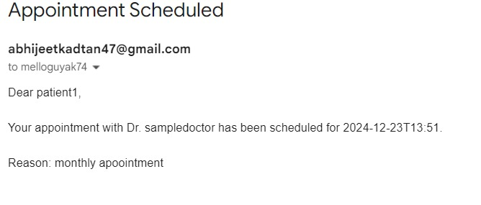
Patient Visibility Email Notification

Slide 30
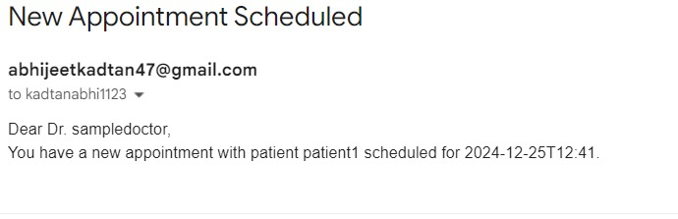
Doctor Visibility Email Notification

Slide 31
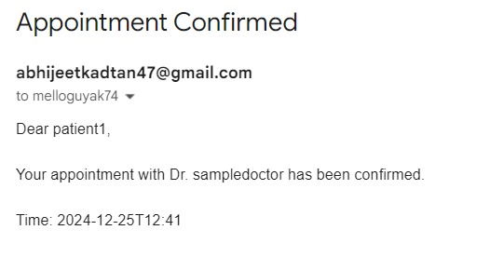
Confirmation Email for Patient

Slide 32
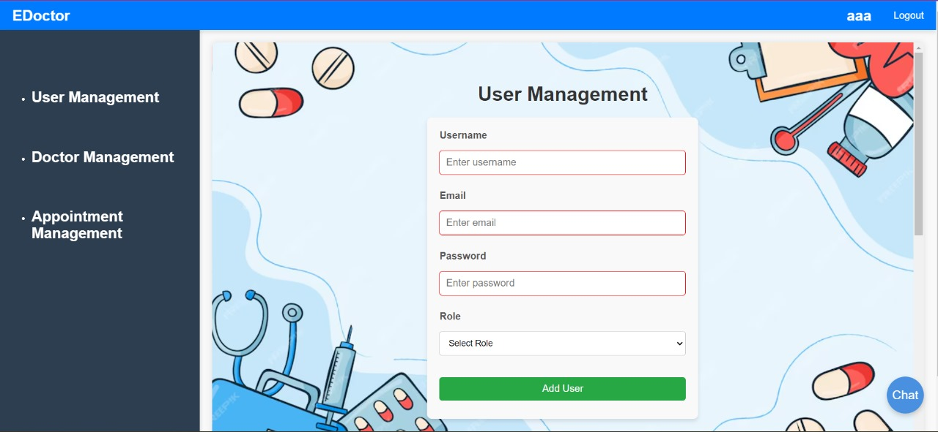
Module 7: Admin Dashboard
Admin Dashboard
Design the layout and functionality of the admin dashboard, implement user management features for admins to add, edit, and delete users, and develop modules for managing doctors, appointments, and patient information.
Admin Dashboard:

Slide 33
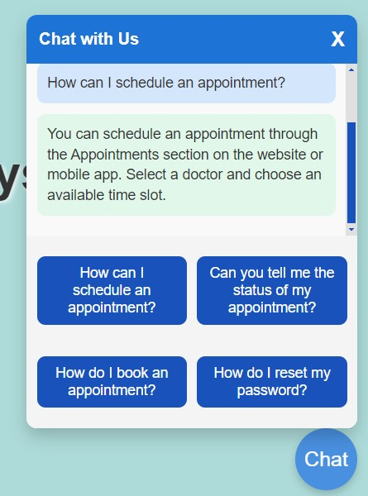
Chat Page for Queries

Slide 34


